Slide 1
Product Sales Prediction
Coding Dojo Project 1
Luke Dibble

Slide 2
The Question: What is the potential sales of a new product?
There are multiple factors that needed to be looked at to attempt to predict this.
Where will the product be released?
What price will the product be listed for?
What level of visibility will the product have?
After reviewing the data from over 8500 different products, these 3 qualifiers seem to have the greatest impact on the potential sales of a product.

Slide 3
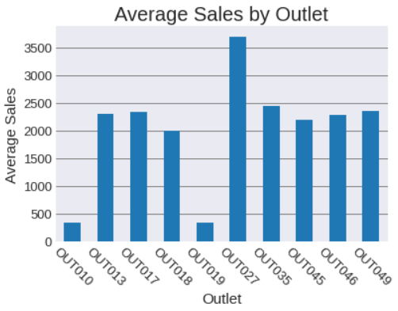
Where matters!!
Notes:
Deciding where to launch a product is important. If a new product is launched at a store with overall poor sales, then it has a fairly good chance of performing poorly. The opposite it true if it is launched at a store with exceptional sales. It could seem to over perform and cause unrealistic expectations.
When building a predictive model, the location will have an effect on the potential overall sales.

Slide 4
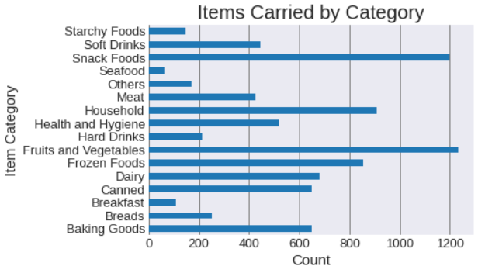
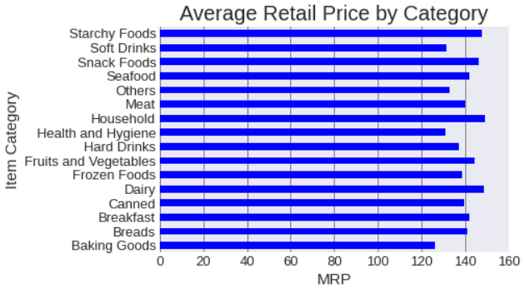
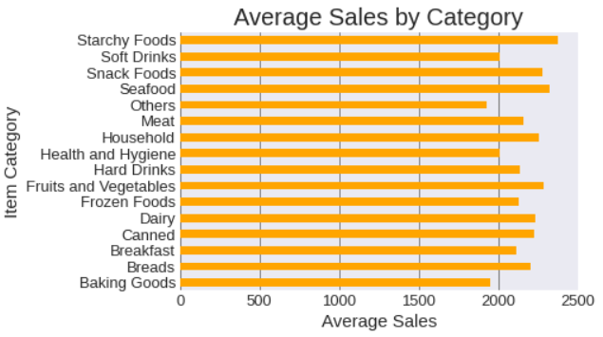
How Much?
Notes:
It should go without saying, the MRP of a product directly affects its potential sales. A smaller quantity of product can be balanced out by a higher MRP (Supply and Demand).

Slide 5
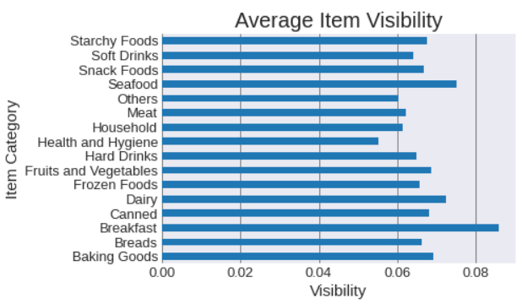
Now you see me!
Notes:
Choosing how visible the item is has nearly as much an affect as choosing which location. The more visible/easier to locate an product, the more likely a sale will be made.

Slide 6
Conclusions
After cleaning the data and evaluating it for relevant information, it was applied to several predictive models.
The final model was based on Product MRP, Product Visibility, and Product Location. Using a Random Forest Regression Model with a max depth of 5, we can predict the potential sales of a new product with decent accuracy.

